Slide 1


Physiology (code)-year 2
Lecture 1 (Oral Cavity and Salivary Glands)
By L . Dr. Rafida Al-Amiri
Basic Science Department
College of Dentistry
University of Basrah

Slide 2
Objectives:
Describe the functions of the mouth and Salivary Glands
Mastication, Deglutition, Swallowing, Digestion
Regulation of Salivary Secretion, Factors Influencing Salivary Flow and Composition

Slide 3
The Mouth or Oral Cavity
Common entrance to the digestive and respiratory tracts.
Site for entry of foodstuffs .
Initial processing of food called mastication and chewing.
Articulation of speech .
Alternate airway .

Slide 4
Mouth
It is important for chewing of food and mastication.
Food will be destroyed into small particles and this increases the
surface area of food exposed to secretion.
This is under the control of extrinsic nervous system and it is usually done by trigeminal and facial nerves.

Slide 5
Anatomy of the Mouth
Delimited anteriorly by the lips and posteriorly by the anterior tonsillar pillars .
The roof of the mouth is formed by the hard and soft palates.
The floor of the mouth is formed by the tongue .
The walls are lined by the buccal mucosa .

Slide 6
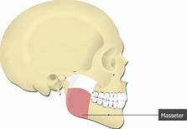
Mastication:
Started voluntary but it will continue automatically by automatic reflex because when food touch the roof of the mouth → reflex inhibition of masseter muscle
→ drop of mandible → stretch of masseter muscle → reflex contraction of
master muscles → food will touch the roof of the mouth again…. .
The chewing center is located in the medulla oblongata.

Slide 7
The importance of chewing are:
1.Breaks down the indigestible cellulose membranes around the nutrient portions of food.
2. Increase the surface area of food so the rate of digestion of food by digestive enzymes is increase.
3. Mixes the food with salivary secretions, which initiates the process of starch digestion (by salivary amylase) and lipid digestion (by lingual lipase) and lubricate and soften the bolus of food, making it easier to swallow.
4. Brings food into contact with taste receptors and releases odors that stimulate the olfactory receptors, which lead to increase the pleasure of eating and initiate gastric secretions.

Slide 8
Swallowing (deglutition):
Swallowing is a complicated mechanism because the pharynx most of the time subserves other functions (e.g. respiration).
The swallowing centre specifically inhibits the respiratory center of the medulla during swallowing, halting respiration at any point in it is cycle to allow swallowing to proceed.

Slide 9
Swallowing can be divided into:
1.Voluntary (oral) phase
2. Involuntary (pharyngeal) phase
3. Esophageal phase
Voluntary (oral) phase: it is done by the tongue . Thus, the tongue
forces the bolus of food into the pharynx. Then the second stage started.

Slide 10
2. Involuntary (pharyngeal) phase: swallowing receptors located around the opening of the pharynx (stimulated by food)→ impulses transmitted by sensory division of trigeminal and glossopharyngeal nerves → swallowing centre (medulla oblongata and lower portion of pons) → motor impulses to pharynx and upper esophagus that cause swallowing are transmitted by 5th (trigeminal N), 9th (glossopharyngeal N), 10th (vagus N), and 12th (hypoglossal N) cranial nerves .
And a few of the superior cervical nerves → series of automatic pharyngeal muscular contractions.

Slide 11
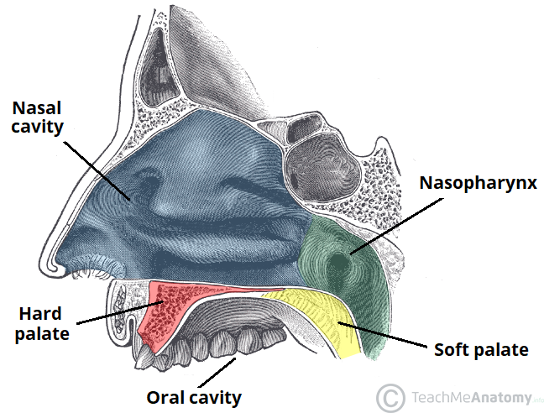
The sequence of events of the pharyngeal stage of the swallowing are as follows:
The soft palate is pulled upward to close the posterior nares and preventing reflex of food into the nasal cavities.

Slide 12
The vocal cords of the larynx are strongly approximated and epiglottis swing backward over the superior opening of the larynx prevent passage of food into the trachea.
The superior constrictor muscle of the pharynx contracts, giving rise to rapid peristaltic wave passing downward over the middle and inferior pharyngeal muscles and into the esophagus, which propels the food into the esophagus.

Slide 13
3. Esophageal phase of swallowing: The esophagus functions to conduct food from the pharynx to the stomach.
Esophagus exhibits two types of peristaltic movements :
Primary peristalsis : which a continuation of the peristaltic wave that begins in the pharynx which passes all the way from the pharynx to the stomach through esophagus.
The peristaltic waves of the esophagus are initiated by vagal reflexes. These reflexes are transmitted through vagal afferent fibers from the esophagus to the medulla and then back again to the esophagus through vagal efferent fibers.

Slide 14
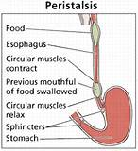
Secondary peristalsis:
Which is generated by the enteric nervous system (ENS) of the esophagus itself, initiated from distension of the esophagus by the retained food if the primary peristalsis fails to move all the food
that has entered the esophagus into the
stomach.

Slide 15
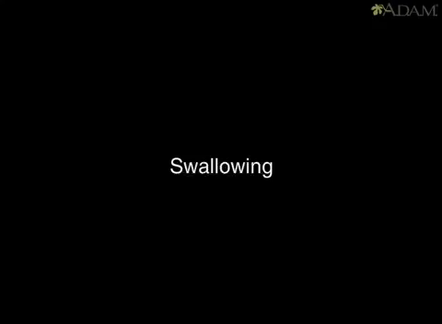

Slide 16
Digestion :
Saliva is responsible for the initial digestion of starch, favoring the formation of the food bolus. This action occurs mainly by the presence of the digestive enzyme α-amylase (ptyalin) in the composition of the saliva. Its biological function is to divide the starch into maltose, maltotriose, and dextrins.
This enzyme is considered to be a good indicator of properly functioning salivary glands, contributing 40% - 50% of the total salivary protein produced by the glands. The greater part of this enzyme (80%) is synthesized in the parotids and the remainder in the submandibular glands. Its action is inactivated in the acid portions of the gastrointestinal tract and is consequently limited to the mouth.

Slide 17
Salivary Glands
In humans, the saliva is secreted by three pairs of major (larger) salivary glands and some minor (small) salivary glands in the oral and pharyngeal mucous membrane.
The major glands are:
1. Parotid glands
2. Submaxillary or submandibular glands
3. Sublingual glands.

Slide 18
1.Parotid glands
Parotid glands are the largest of all salivary glands situated at the side of the face just below
and in front of the ear.
2.Submaxillary glands
Submaxillary glands or submandibular glands are located in submaxillary triangle medial to mandible.
3.Sublingual glands
Sublingual glands are the smallest salivary glands situated in the mucosa at floor of mouth.

Slide 19
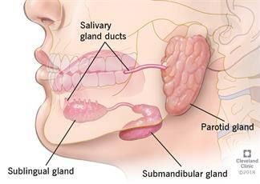
Major salivary glands

Slide 20
Minor salivary glands
Collection of secretory cells scattered throughout the mucosa & submucosa of the oral cavity with short ducts opening directly onto mucosal surface.
These are :
Lingual mucus glands situated in posterior 1/3 of the tongue
Lingual serous glands
Buccal glands
Labial glands
Palatal glands.

Slide 21
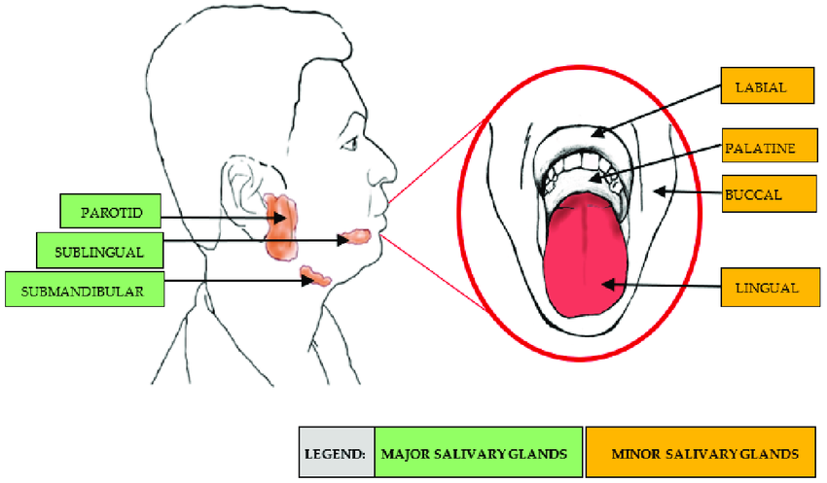

Slide 22
Classification of salivary glands
Salivary glands are classified into three types based on the type of secretion:
1. Serous Glands
This type of glands are predominantly made up of serous cells. These glands secrete thin and watery saliva. Parotid glands and lingual serous glands are serous glands.
2. Mucus Glands
This type of glands are made up of mainly the mucus cells. These glands secrete thick, viscus saliva with high mucin content. Lingual mucus glands, buccal glands and palatal glands belong to this type.
3. Mixed Glands
Mixed glands are made up of both serous and mucus cells. Submandibular, sublingual and labial glands are the mixed glands.

Slide 23
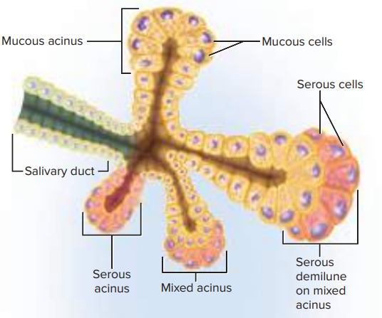
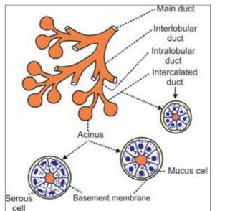
Structure and duct system of salivary glands
Salivary glands are made up of acini or alveoli. Each acinus is formed by a small group of
cells which surround a central globular cavity. The central cavity of each acinus is continuous with the lumen of the duct. The fine duct draining each acinus is called intercalated duct. Many
intercalated ducts join together to form intralobular duct. Few intralobular ducts join to form
interlobular ducts, which unite to form the main duct of the gland.
Diagram showing acini and duct
system in salivary glands

Slide 24
Regulation of Salivary Secretion
Secretion of saliva is continuous, but the amount varies in different situations.
The presence of food (or anything else) in the mouth increases saliva secretion. This is a parasympathetic response mediated by the facial and glossopharyngeal nerves.
The sight or smell of food also increases secretion of saliva.
Sympathetic stimulation in stress situations decreases secretion, making the mouth dry and swallowing difficult.

Slide 25
Control of salivary gland:
It is completely under the control of autonomic nervous system:
a. Parasympathetic nervous signals from the salivatory nuclei that located at the juncture of the medulla and pons → increase salivary secretion by stimulating the muscarinic receptors due to the release of acetylcholine and the parasympathetic stimulation is initiated by the presence of food in the mouth.
Drugs that block muscarinic receptors like atropine inhibit salivary secretion and leads to dryness of the mouth.
b. Sympathetic stimulation → will decrease salivary secretion as in fear so person can not speak normally.

Slide 26

Which the nerves increases the salivary secretion?

Slide 27
Development of salivary glands
Parotid: 4-6 th week of I.U. life.
Submandibular :6 th week of I.U. life.
Sublingual and minor salivary gland : 8 th week of intrauterine life.
Maturity of secretory end piece: During last 2 months of gestation.
Secretory component of gland continues to grow postnatally while as ductal, connective tissue component and vascular component decreases- up to two years of age.

Slide 28
Systemic Diseases and Nutrition In some chronic diseases such as: pancreatitis, diabetes mellitus, renal insufficiency, anorexia, bulimia, and celiac disease, the amylase level is high.
Alterations in the psycho-emotional state may alter the biochemical composition of saliva. Depression is accompanied by diminished salivary proteins.
Nutritional deficiencies may also influence salivary function and composition.
Clinical Significance Since many oral and systemic conditions manifest themselves as changes in the flow and composition of saliva.

Slide 29
Factors Influencing Salivary Flow and Composition
Several factors may influence SF and its composition. As a result, these
vary greatly among individuals and in the same individual under different circumstances.
1.Individual Hydration
The degree of individual hydration is the most important factor that interferes in salivary secretion. When the body water content is reduced by 8%, SF virtually diminishes to zero, whereas hyperhydration causes an increase in SF. During dehydration, the salivary glands cease secretion to conserve water.

Slide 30
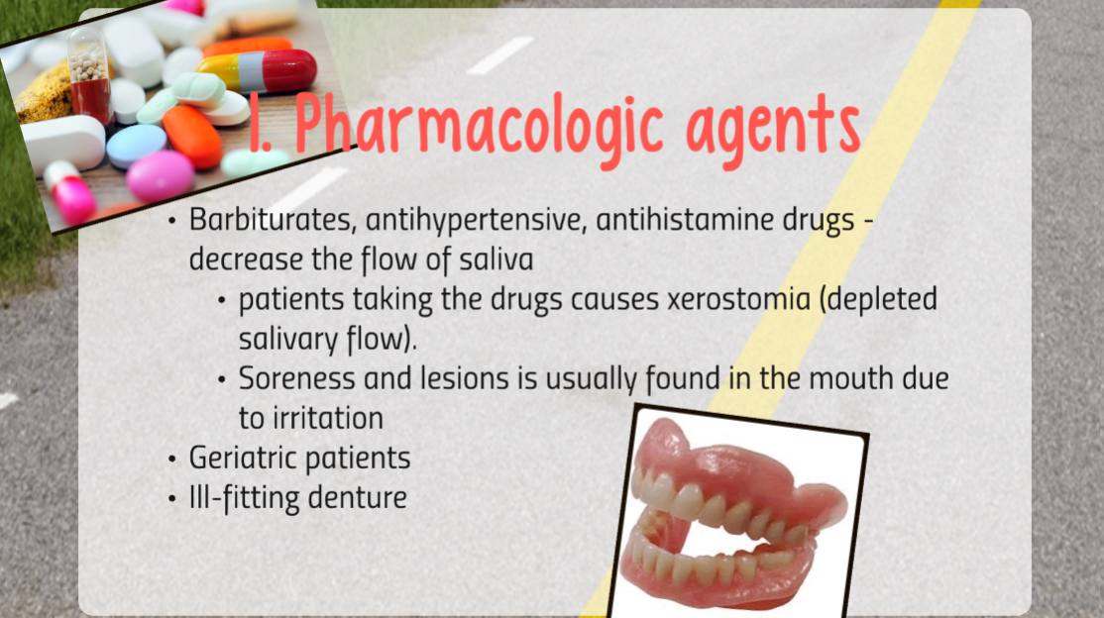

Slide 31
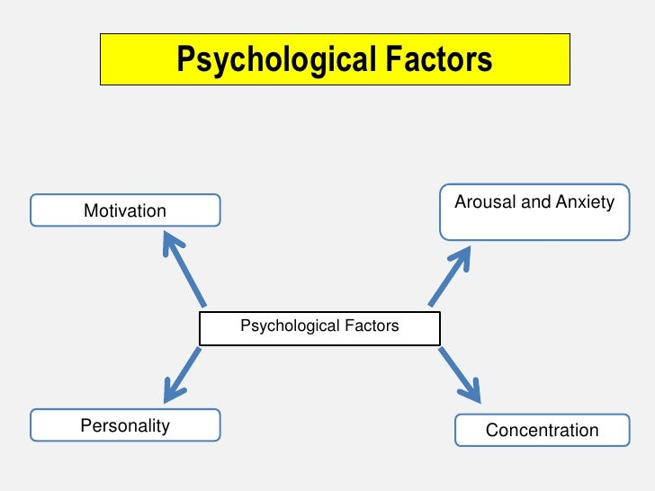

$$2$$

Slide 32


Slide 33
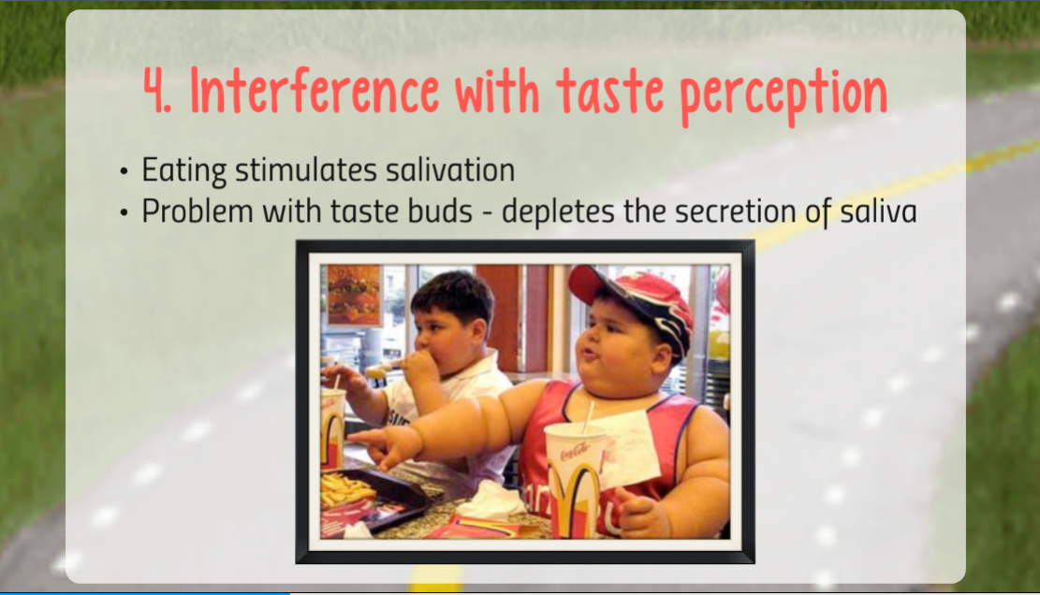

Slide 34


Slide 35
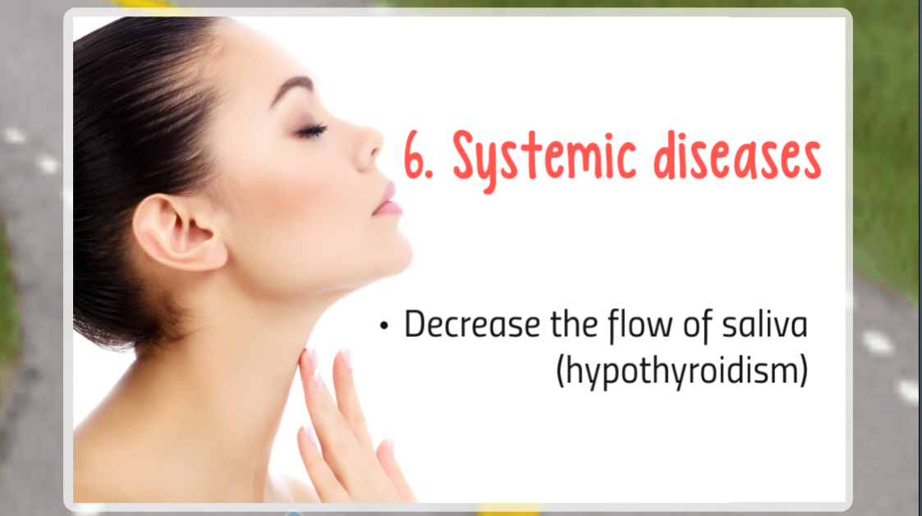

Slide 36
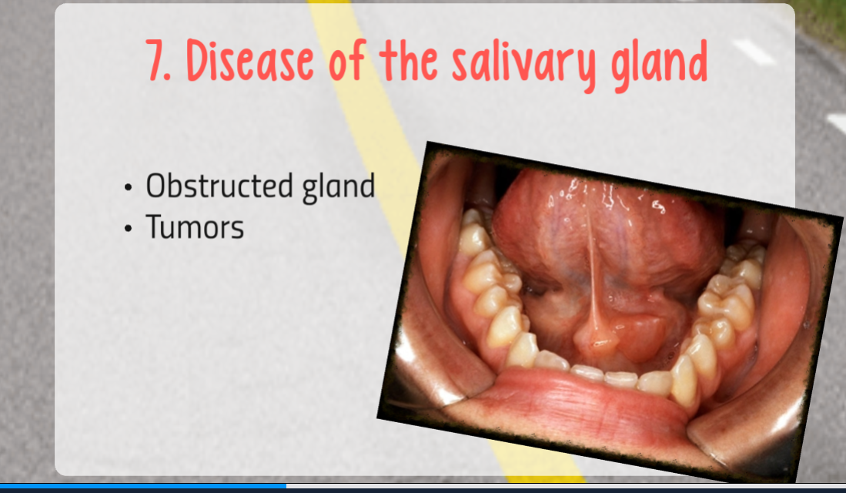

Slide 37
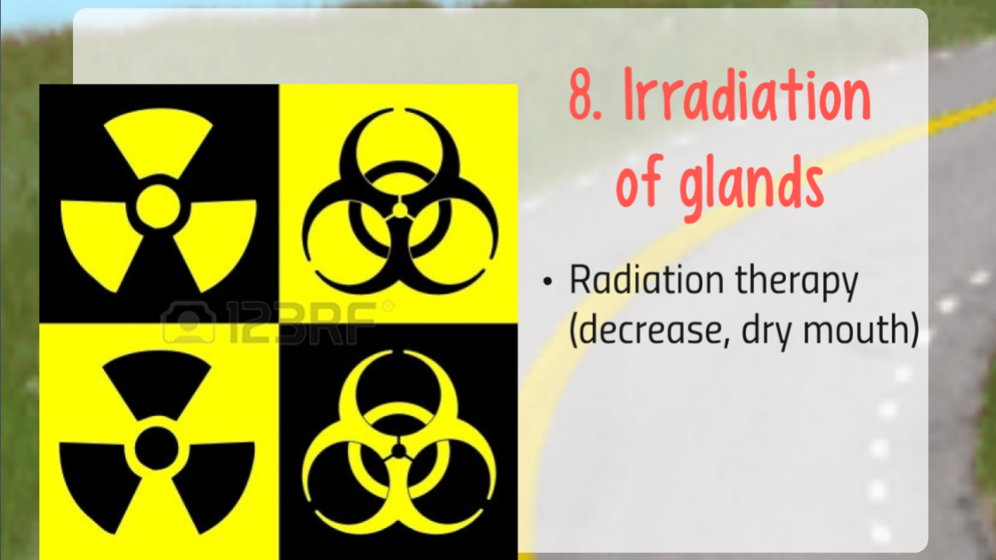

Slide 38


